Slide 1

Put On Your Big Girl Panties And Go To Work
If I knew then what I know now.
I would have been a better leader, friend, wife, daughter, boss, and employee.
Sometimes it takes something catastrophic to deal with the important things.
Something wonderful came out of this experience.
Yesterday’s Gone Women’s Shelter and a workbook to help others.

Slide 2

The Emotional Journey Begins
Why it is important to process emotions
How emotions effect the workplace
How to process emotions
Understand dysfunctional thought processes that contribute to emotions
How to be emotionally intelligent and improve in weak areas
How to create an emotionally intelligent workplace
How to implement processes to help employees process emotions

Slide 3
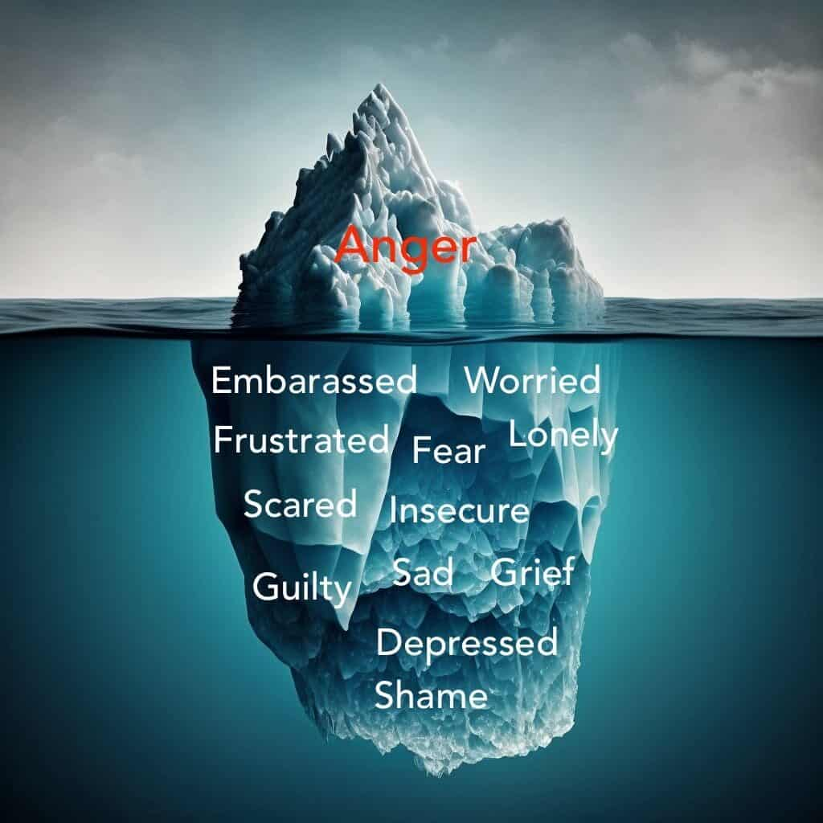

Slide 4

The Importance of Processing Emotions
  Imagine that I have some food delivered by Uber Eats and I never take the food inside.
  The food just sits out there and what happens is there are rodents, pests, and bugs coming around the food.
  That's pretty much the same thing that happens when you don't deal with your emotions.
  It becomes a mess and all sorts of issues arise.

Slide 5
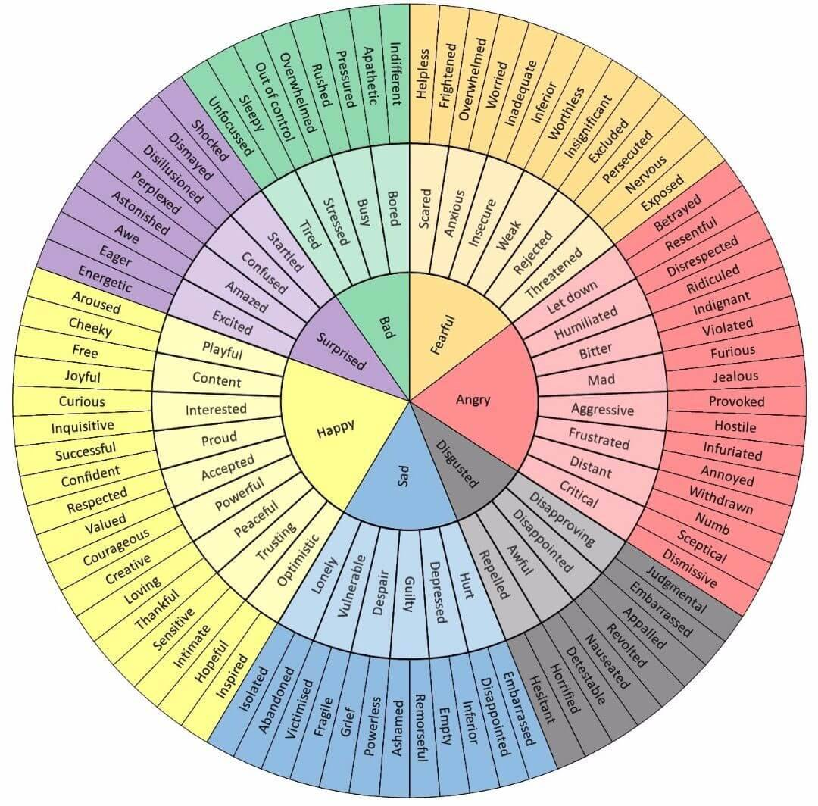
How to Identify Emotions

Slide 6
How to Identify Emotions From the Body
Location of Sensation | Basic Emotion | Secondary and Tertiary Emotions
Neck, shoulders, jaw, and upper chest | Anger | Frustrated, humiliated, resentful, provoked
Stomach or gut (knot) | Shame | Guilt, embarrassed, exposed, regretful
Heart (stabbing pain) | Sadness | Lonely, vulnerable, disappointed, despair
Chest and lungs (rapid breathing, shortness of breath) | Fear | Anxious, insecure, rejected, overwhelmed, worried, insignificant
Entire body (lightness or heaviness) | Joy | Optimistic, confident, hopeful, inspired, valued
Chest (warmth and swelling) | Love | Sensitive, aroused, compassion, affectionate

Slide 7
Emotions and Distorted Thoughts
Catastrophizing
Filtering
Mind Reading
All or Nothing
Personalizing
Overgeneralizing
Rationalizing

Slide 8
Emotion Tracker
Time of Day (Morning, Afternoon, Evening, Night) | What do you feel? (Name the emotion.) | Where do you feel the emotion in your body? | What do you think about the emotion (good, bad, dumb, painful, …) | What do you say to yourself when you are having this emotion?
 | Example: Depression and sadness | Heart | I hate this emotion and would do anything to not have it. | I am depressed because I am going through a hard time and it will eventually pass.

Slide 9
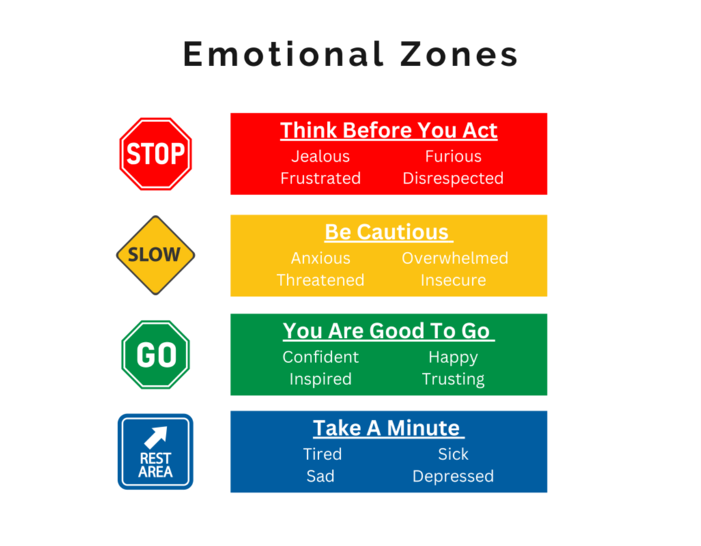

Slide 10
What is Emotional Intelligence
We have all heard of IQ, but there is such a thing as EQ or emotional intelligence.
1
Definition: the ability to be aware of and manage one’s own emotions as well as the emotions of others.
2
Four main areas: self awareness, self management, social awareness, and relationship management.
3
Benefits of a high EQ: managing relationships, handling difficult situations, and conflict resolution.
4

Slide 11
Programs to Manage Emotions
Know your triggers and their triggers.
Manage your approach (hammer and nail does not work most of the time).
Assist employees with exercises to process emotions.
Assist employees in establishing work life balance and setting boundaries.
Assist employees in setting boundaries.
In these scenarios if you do not have the patience or desire to do things properly, have a designee that can do it for you.

Slide 12
Workbook

